Slide 1
Unsupervised Learning

Slide 2
Unsupervised learning
Labeled data (data whose classification is known) are sometimes not available
Sometimes not even the classes and their characteristic features are known
Clusters are data groups in which the points have small distances/high similarity, where the different clusters have a large distance/low similarity

Slide 3
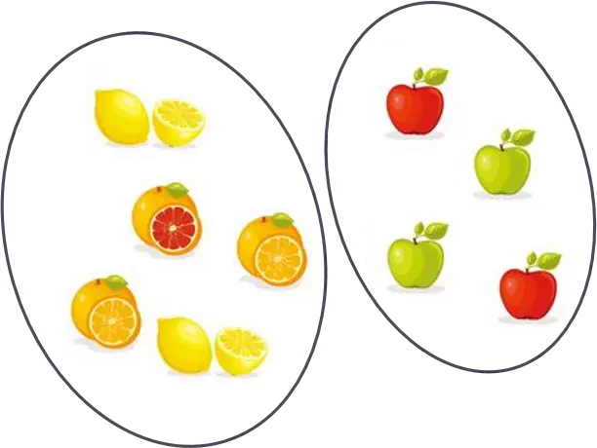
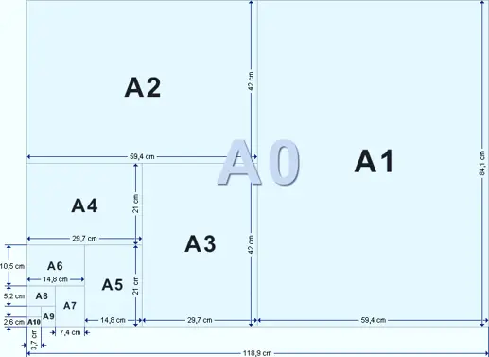
Unsupervised learning
Raw data processing
No desired response vectors
Finding similarities
Distinguish groups
Cluster analysis
Dimensionality reduction
Cluster analysis
Dimensionality reduction

Slide 4
Clustering

Slide 5
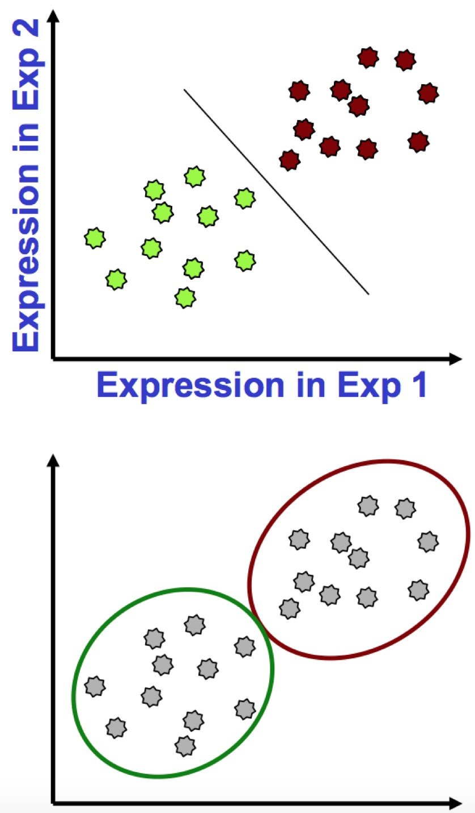
Clustering vs. classification
Objects are characterized by one or more features
Classification
Points have labels
Want a “rule” that will accurately assign labels to new points
Supervised learning
Clustering
No labels
Group points into clusters based on how “near” they are to one another
Identify structure in the data
Unsupervised learning

Slide 6
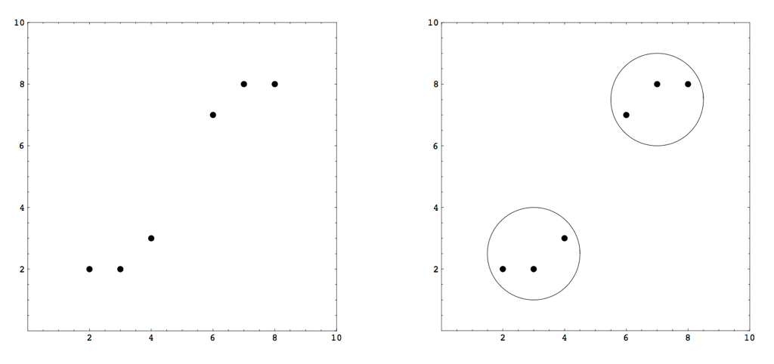
What is a cluster?
A group of data in which the elements are very similar/close to each other, while the data in different clusters are significantly different/distant from each other.

Slide 7
Reasons for the usage
Labeled (classified) data are not always available
Sometimes even classes or characteristic properties are not known
Reducing the number of data

Slide 8
Few application
Signal and image decomposition
Data analysis
Market analysis (identification of target customer groups)
Content management (grouping similar documents)
Fuzzy rule extraction
...

Slide 9
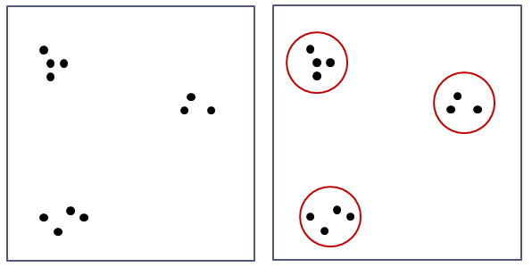
A simple example
We want to build the rule base from a dataset
The data set must first be clustered
Simple example:

Slide 10
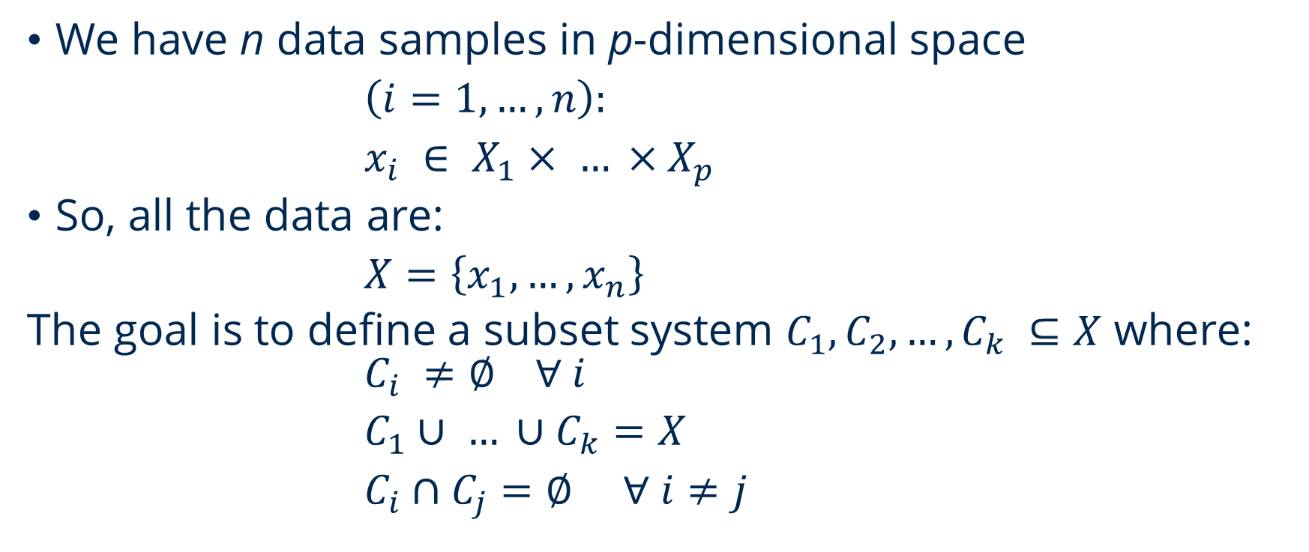
Basic requirements
We have n data samples in p-dimensional space
$\left(i=1, …, n\right):$
$x_{i} ∈ X_{1}× … ×X_{p}$
So, all the data are:
$X=\left\{x_{1},…,x_{n}\right\}$
The goal is to define a subset system $C_{1},C_{2},…,C_{k} ⊆X$ where: $C_{i} ≠\text{∅} ∀ i$
$C_{1}∪ … ∪C_{k}=X$
$C_{i}∩C_{j}=\text{∅}$ $∀ i≠j$

Slide 11
Agglomerative clustering
We start with the most rigorous clustering, i.e. n single-element clusters
Then we iteratively merge the two closest clusters
We continue until we have only one cluster with all the data elements
We do not create a partition, but a sequence of partitions
We do not need to specify the number of clusters in advance
Most of these methods are slow and only work on small data sets

Slide 12
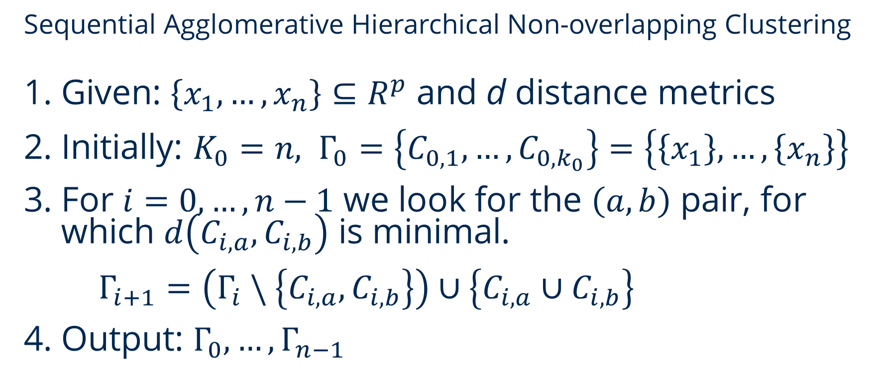
SAHN Clustering
Sequential Agglomerative Hierarchical Non-overlapping Clustering
Given: $\left\{x_{1},…,x_{n}\right\}⊆R^{p}$ and d distance metrics
Initially: $K_{0}=n, Γ_{0}=\left\{C_{0,1},…, C_{0,k_{0}}\right\}=\left\{\left\{x_{1}\right\},…,\left\{x_{n}\right\}\right\}$
For $i=0, …, n−1$ we look for the $\left(a,b\right)$ pair, for which $d\left(C_{i,a},C_{i,b}\right)$ is minimal.
$Γ_{i+1}=\left(Γ_{i} \backslash \left\{C_{i,a},C_{i,b}\right\}\right)∪\left\{C_{i,a}∪C_{i,b}\right\}$
Output: $Γ_{0},…,Γ_{n−1}$

Slide 13
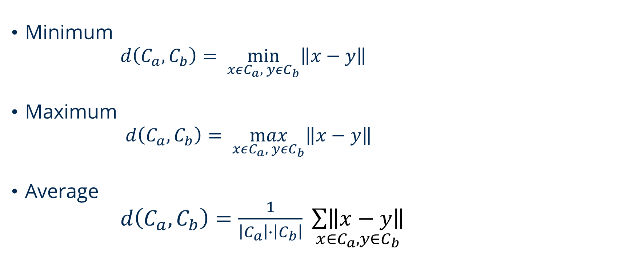
SAHN distance metrics
Minimum
$d\left(C_{a},C_{b}\right)= \min_{xεC_{a}, yεC_{b}}\left\|x−y\right\|$
Maximum
$d\left(C_{a},C_{b}\right)= \max_{xεC_{a}, yεC_{b}}\left\|x−y\right\|$
Average
$d\left(C_{a},C_{b}\right)=\frac{1}{\left|C_{a}\right|∙\left|C_{b}\right|} \underset{x∈C_{a},y∈C_{b}}{\sum{\left\|x−y\right\|}}$

Slide 14
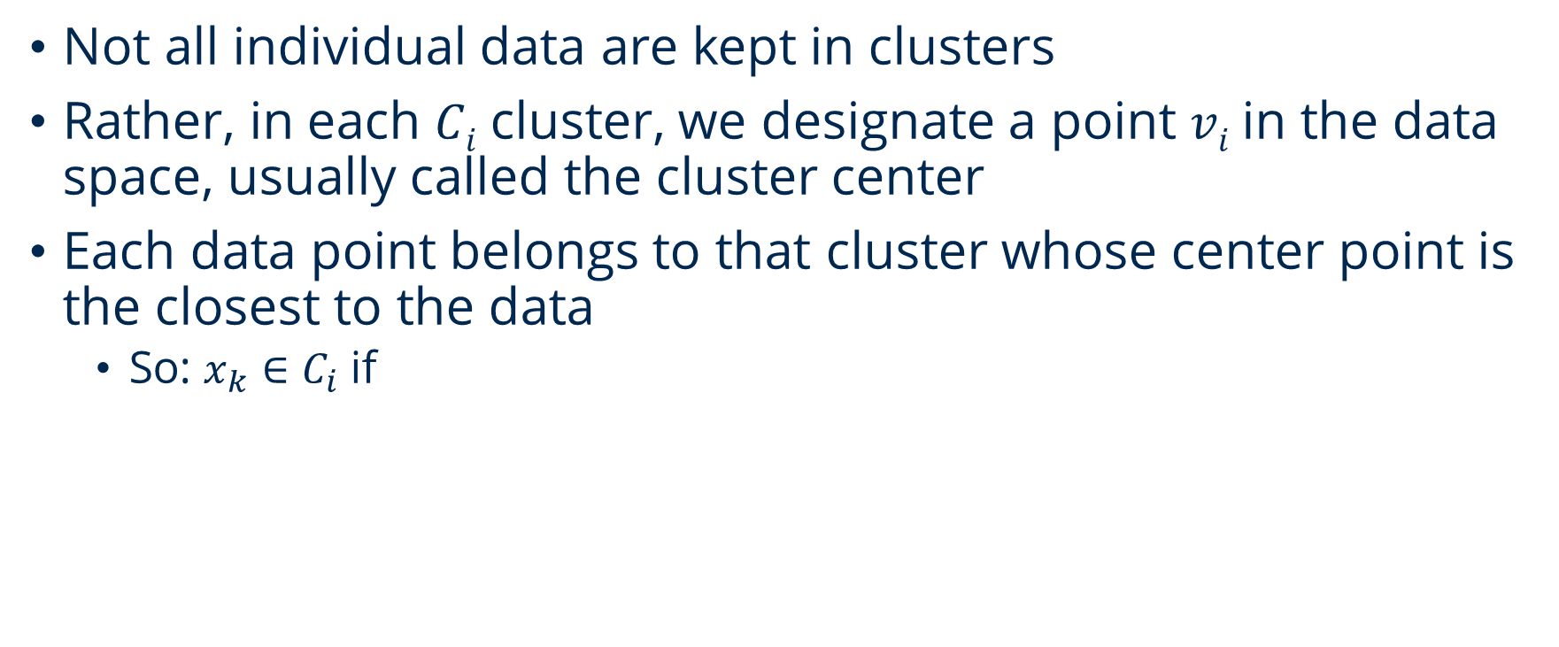
Prototype based clustering
Not all individual data are kept in clusters
Rather, in each 𝐶_{𝑖} cluster, we designate a point 𝑣_{𝑖} in the data space, usually called the cluster center
Each data point belongs to that cluster whose center point is the closest to the data
So: $x_{k}∈C_{i}$ if

Slide 15
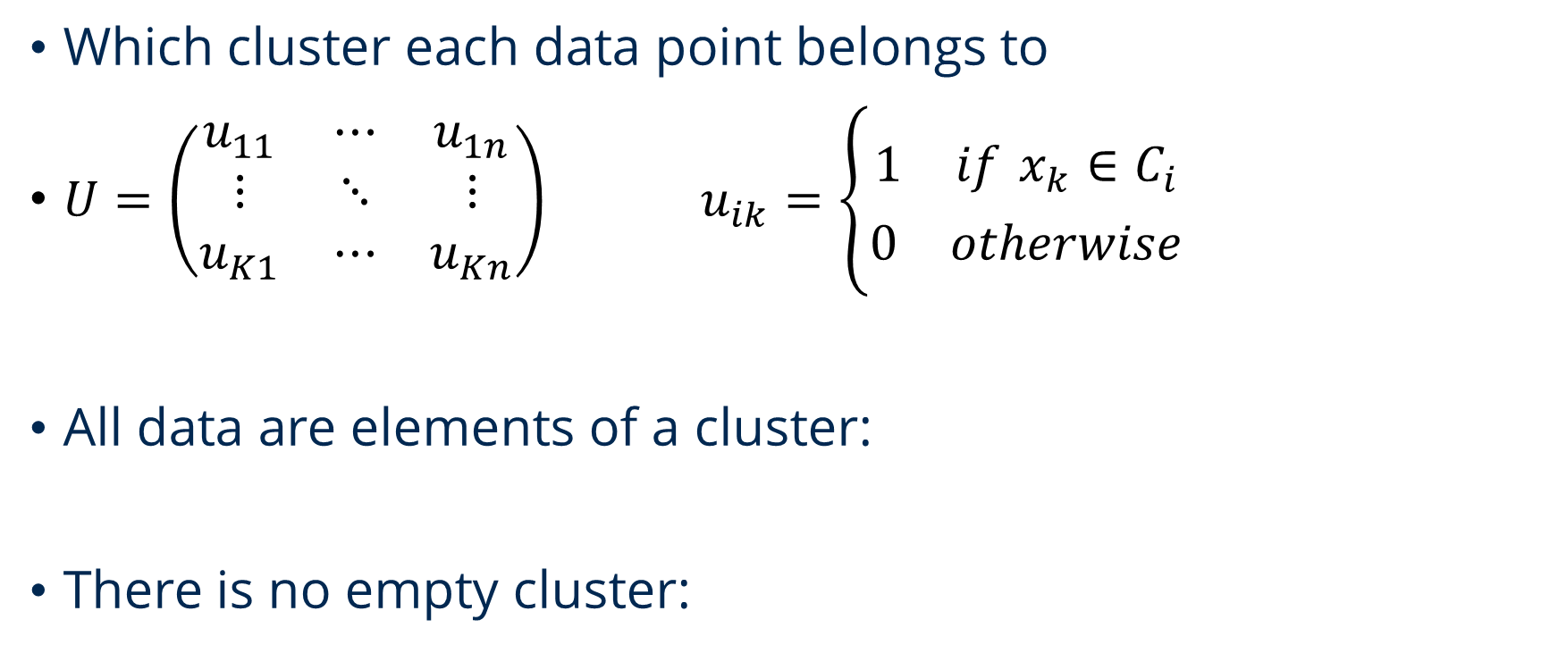
Partition matrix
Which cluster each data point belongs to
$U=\left(\begin{matrix}u_{11} & ⋯ & u_{1n} \\ ⋮ & ⋱ & ⋮ \\ u_{K1} & ⋯ & u_{Kn}\end{matrix}\right)$ $u_{ik}=\left\{\begin{matrix}1 if x_{k}∈C_{i} \\ 0 otherwise\end{matrix}\right.$
All data are elements of a cluster:
There is no empty cluster:

Slide 16
k-means clustering
Iterative process for clustering
Minimize the following function
Calculating the centroids
(1)

Slide 17
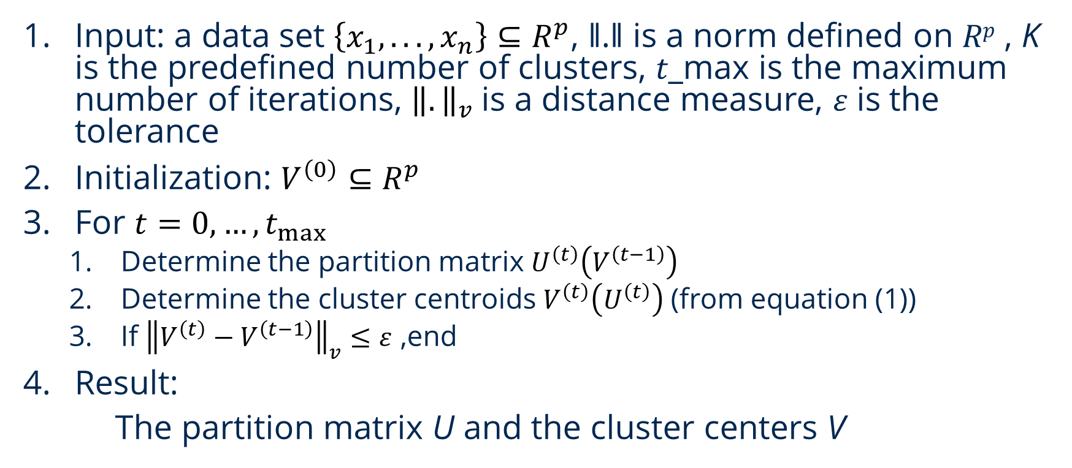
k-means clustering
Input: a data set $\left\{x_{1},...,x_{n}\right\}⊆R^{p}$, ‖.‖ is a norm defined on $Rp$ , K is the predefined number of clusters, 𝑡_max is the maximum number of iterations, ${\left\|.\right\|}_{v}$is a distance measure, 𝜀 is the tolerance
Initialization: $V^{\left(0\right)}⊆R^{p}$
For ${t=0, …, t}_{max}$
Determine the partition matrix $U^{\left(t\right)}\left(V^{\left(t−1\right)}\right)$
Determine the cluster centroids $V^{\left(t\right)}\left(U^{\left(t\right)}\right)$ (from equation (1))
If ${\left\|V^{\left(t\right)}−V^{\left(t−1\right)}\right\|}_{v}≤ε$ ,end
Result:
The partition matrix U and the cluster centers V

Slide 18
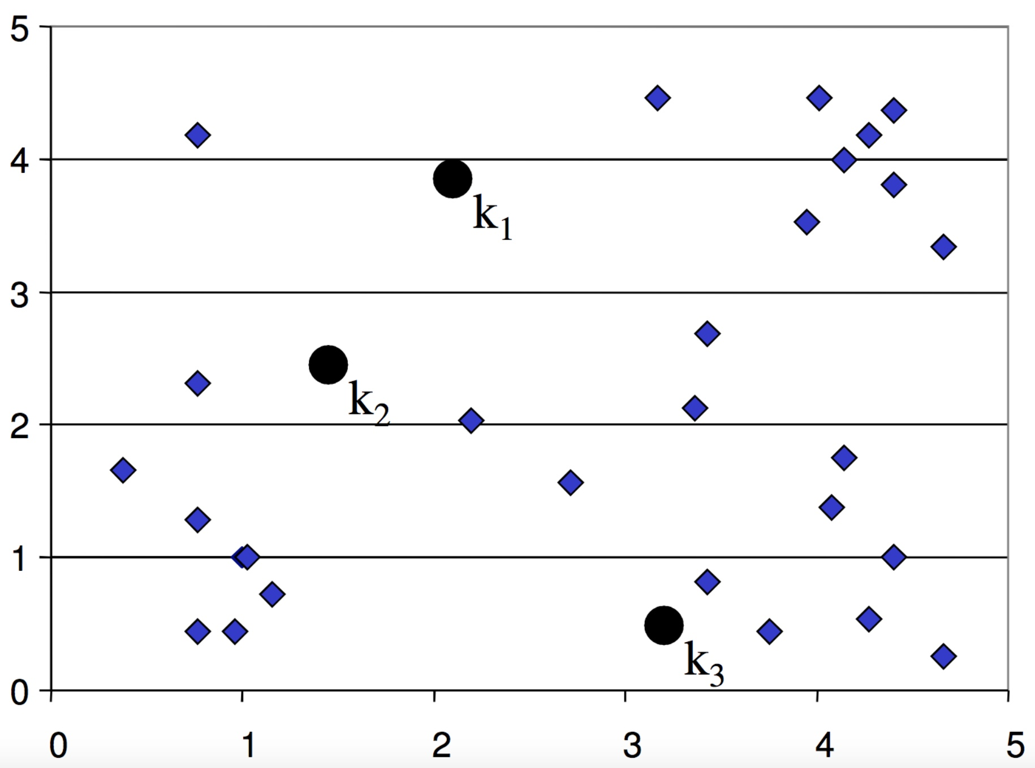
k-means clustering
Initialization:
decide K
initialize K cluster centers randomly

Slide 19
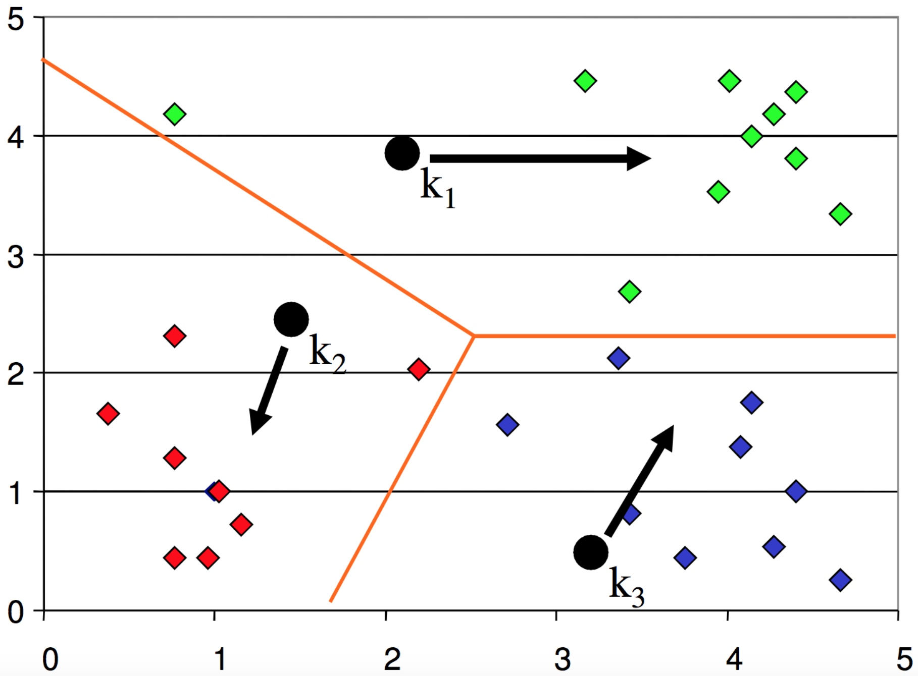
k-means clustering
Iteration:
assign all points to the nearest cluster center
move the centers to the mean of their members

Slide 20
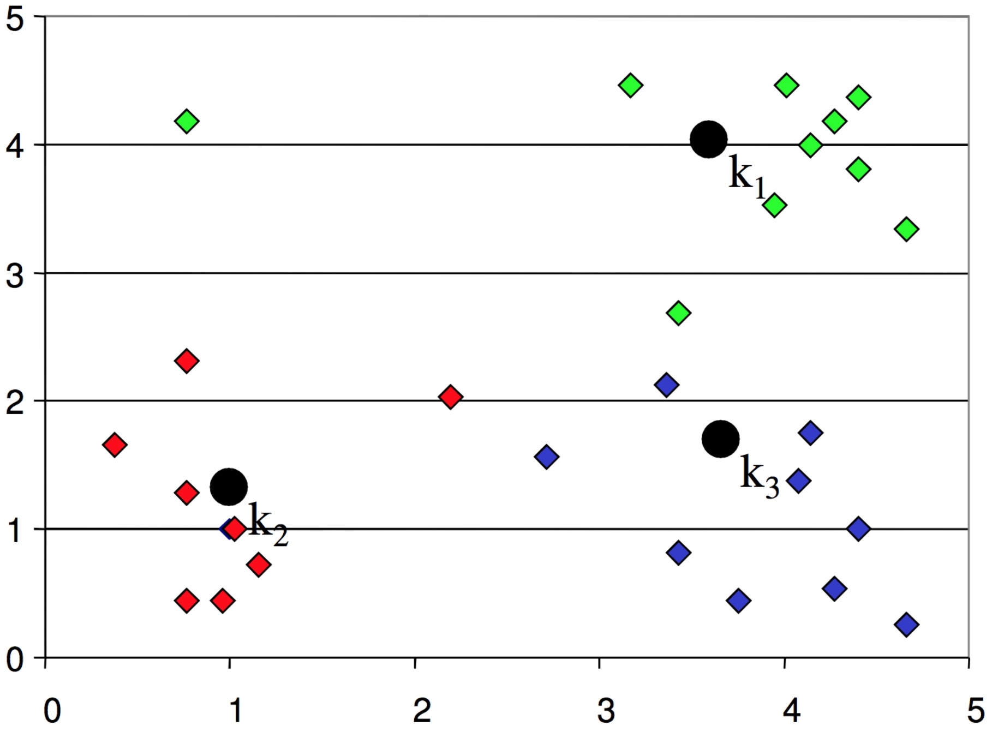
k-means clustering
Iteration:
after moving centers, re-assign the points to the nearest center

Slide 21
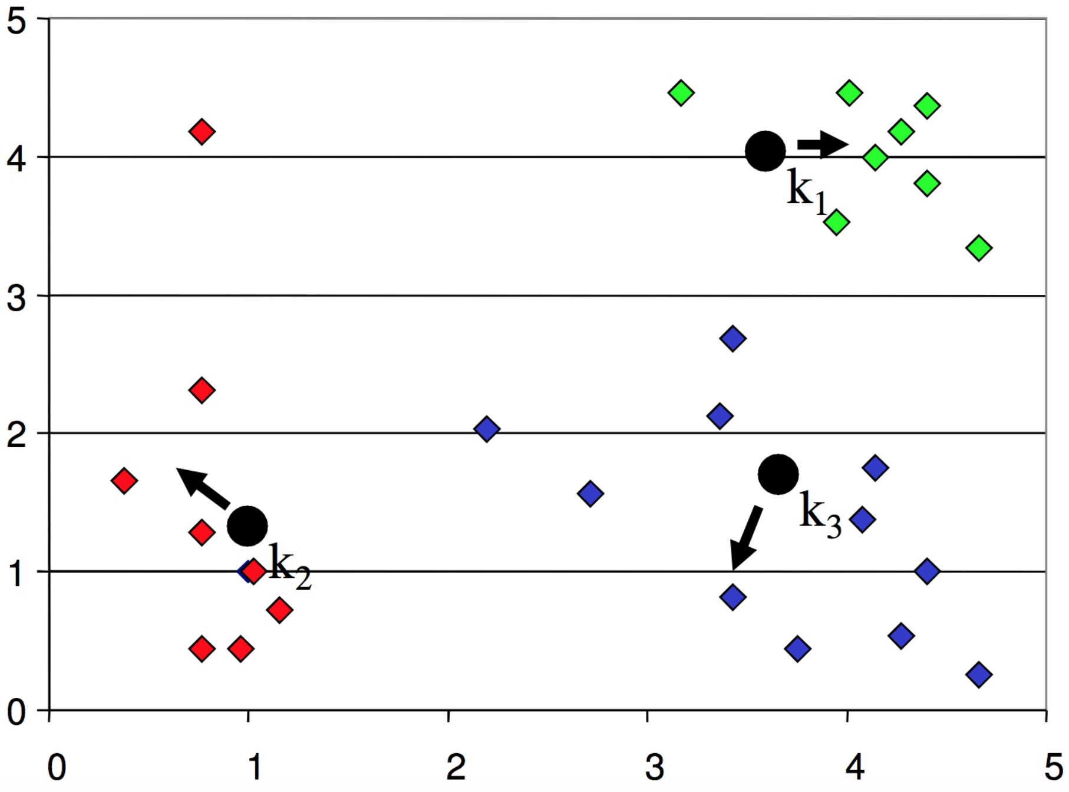
k-means clustering
Iteration:
move the centers to the mean of their members

Slide 22
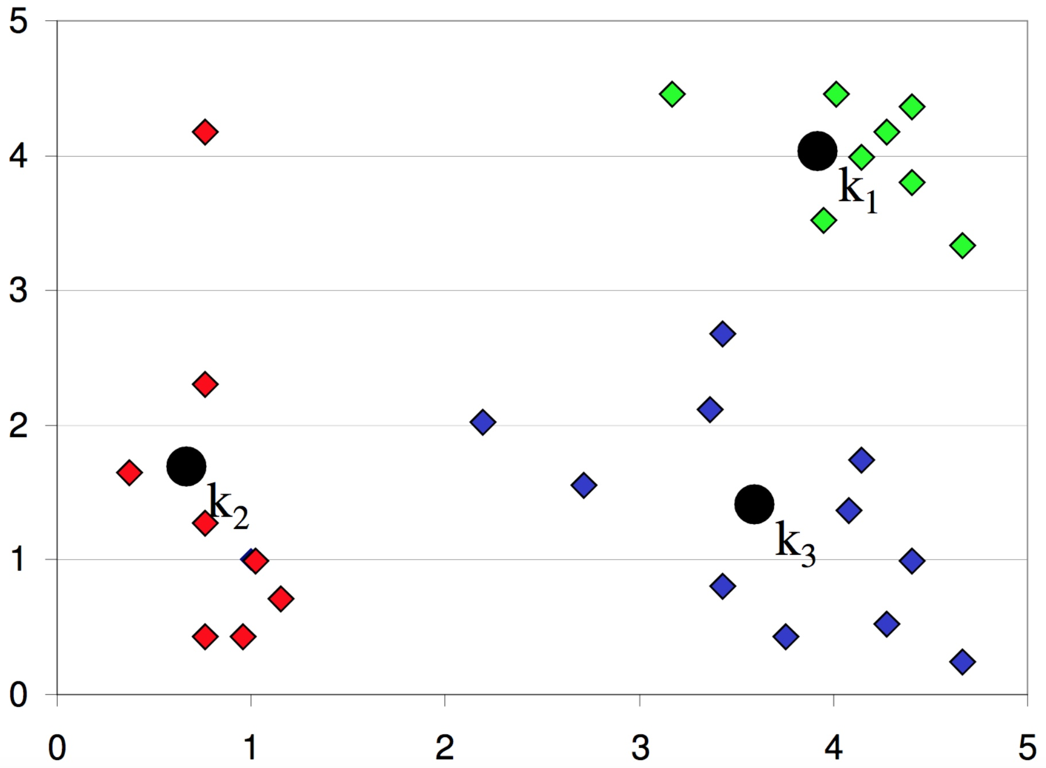
k-means clustering
Finished:
re-assign and move centers, until no points changed membership

Slide 23
k-means clustering
1. Decide the value of K, the number of clusters
2. Initialize the K cluster centers randomly
3. Decide the class membership of the N points by assigning them to the nearest cluster center
4. Re-estimate the K cluster centers, by assuming the memberships found above are correct
5. Repeat 3 and 4 until none of the N points changed membership in the last iteration

Slide 24
k-means clustering
Strength:
Simple, easy to implement
Intuitive objective function: optimizes intra-cluster similarity
Relatively efficient: O(t⋅k⋅n), where n: number of points (data), k: number of clusters, t: number of iterations, usually: k,t<<n
Weakness:
Applicable only when mean is defined
Often terminates at a local optimum. Initialization is important
Need to specify K, the number of clusters, in advance
Unable to handle noisy data and outliers
Not suitable to discover clusters with non-convex shapes

Slide 25
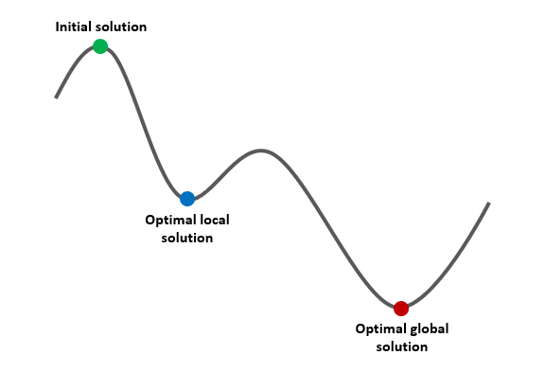
k-means clustering
Initialization of centroids can influence the final clustering result

Slide 26
How to define the right number of clusters?

Slide 27
How to define the right number of clusters?

Slide 28
How to define the right number of clusters?

Slide 29
How to define the right number of clusters?

Slide 30
How to define the right number of clusters?

Slide 31
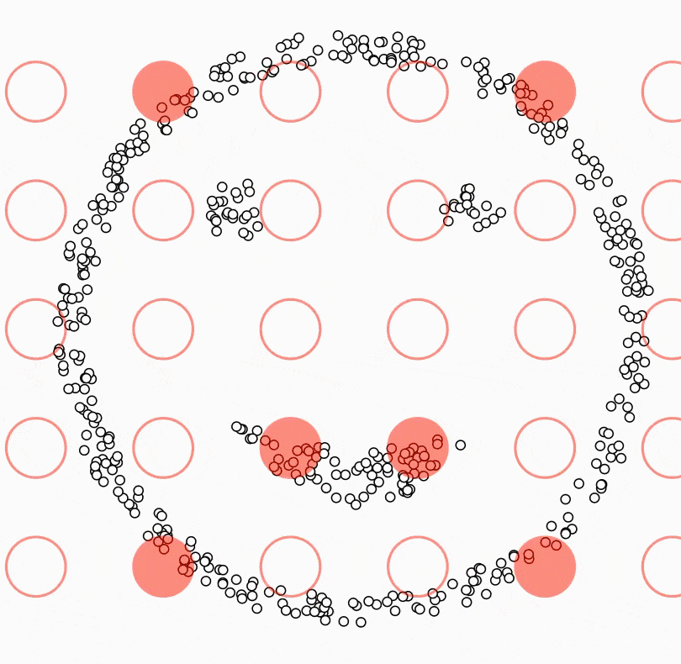
Density-Based Spatial Clustering of Applications with Noise (DBSCAN)
Set the parameters:
Epsilon (ε): The maximum distance between two data points for them to be considered neighbors.
MinPts: The minimum number of data points required to form a dense region.
Start with an arbitrary unvisited data point.
If the point has not been visited, mark it as visited.
Retrieve all its neighboring points within distance ε.
Check the density of the current point:
If the number of neighboring points is greater than or equal to MinPts, the point is considered a core point.
If the number of neighboring points is less than MinPts, the point is considered a border point.
Expand the cluster:
If the point is a core point, create a new cluster and add the point to the cluster.
Retrieve all the reachable neighboring points (directly or transitively) from the core point within distance ε.
Add these points to the cluster and mark them as visited.
Repeat steps 2 to 4 for all unvisited data points in the dataset.
If a border point is encountered, it is not added to any cluster.
The algorithm continues until all data points have been visited.
Classification of noise: Any unvisited data point that does not belong to any cluster is considered noise.
The final result is a set of clusters, where each cluster consists of the core points and their reachable neighboring points.

Slide 32
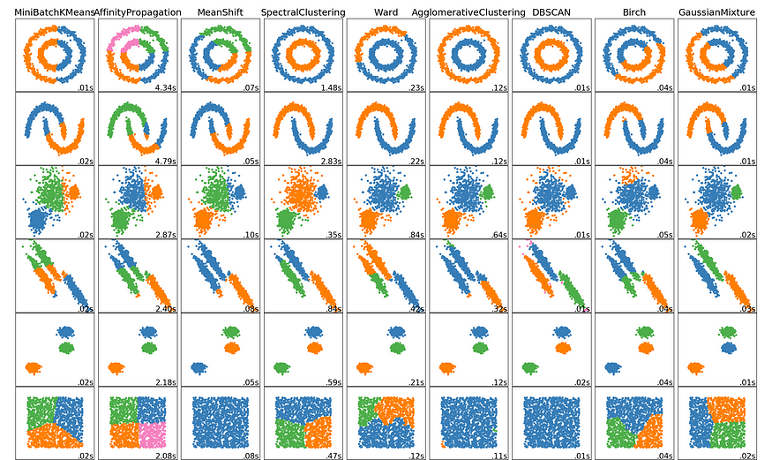
Comparison of clustering algorithms

